Slide 1
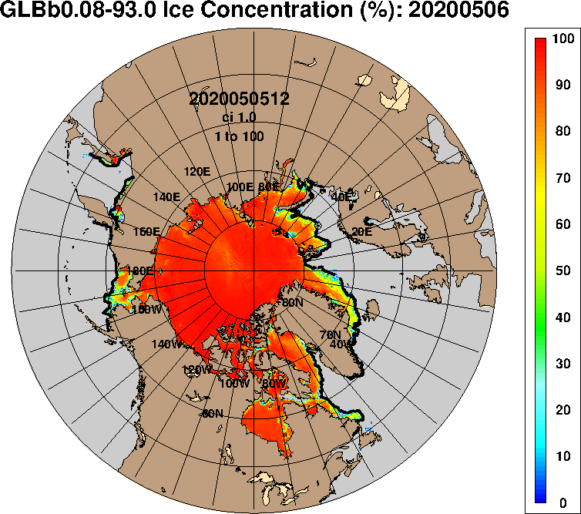

ADAC Year 7 Annual Meeting
...Via Conference Call, 2-3 June 2021
ADAC Project Briefing
Oil Spill Modeling for Improved Response to Arctic Maritime Spills
Nancy E. Kinner, Megan Verfaillie, Jessica Manning
Coastal Response Research Center
Center for Spills and Environmental Hazards
University of New Hampshire
Image Source: https://www7320.nrlssc.navy.mil/GLBhycomcice1-12/arctic.html

Slide 2
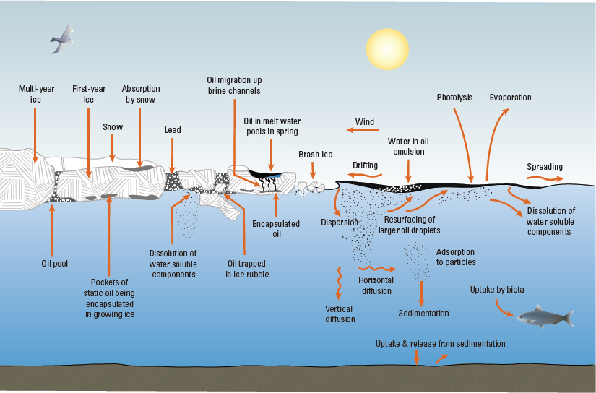
ADAC Program Year 7 Annual Meeting 2-3 June 2021
Oil Spill Modeling for Improved Response to Arctic Maritime Spills
Project Principal Investigators: Nancy E. Kinner
Lead Institution: University of New Hampshire Coastal Response Research Center (CRRC), Center for Spills and Environmental Hazards
Project Champion: Kristen Trego (HQ USCG 5RI)
Project Support:
  Sarah Allan (NOAA OR&R ARD)
  MST1 Gary Barnum (PacArea MST1)
  Catherine Berg (NOAA OR&R ERD SSC)
  Mike Donnellan (Alaska DEC)
  Mark Everett (USCG D17)
  Amy MacFadyen (NOAA OR&R ERD)
  Dr. Phillip McGillivary (USCG PacArea)
  LCDR Cliff Graham (HQ USCG MER)
Project Advocates: NOAA ORR and USCG PACAREA and D17
Oil and Ice Interactions
Source: Fisheries and Oceans Canada

Slide 3
Description
ADAC Program Year 7 Annual Meeting 2-3 June 2021
Oil Spill Modeling for Improved Response to Arctic Maritime Spills
Project provides structured approach to gather expert advice to develop models that address USCG Federal On Scene Coordinator (FOSC) core needs during Arctic spill response.
Overall objective is to identify:
  Specific needs to be addressed to obtain models that will be functional and effective in response time scale to advance FOSC decision-making during an incident as well as improve experience gained from exercises and drills
  Current state-of-the-art Arctic maritime oil spill response models
  Potential integration of these models and components from recent research efforts (integration of ice models with oil spill models)
  Gaps in current models that need to be addressed by future research
Project outcome: Knowledge product/comprehensive report that delineates characteristics of Arctic oil spill response that make models appropriate required for daily response planning and decision-making

Slide 4
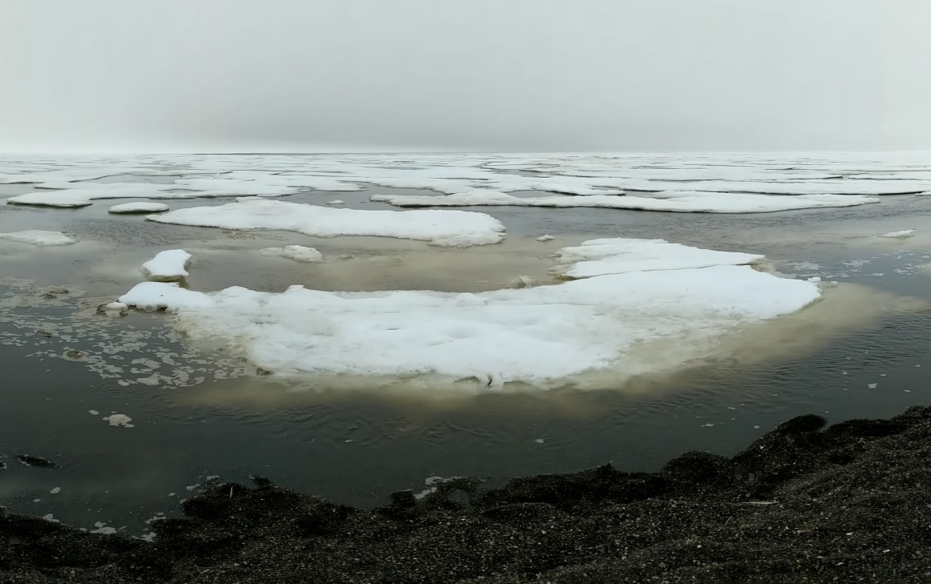
Oil Spill Modeling for Improved Response to Arctic Maritime Spills
Baseline: Arctic Environment
ADAC Program Year 7 Annual Meeting 2-3 June 2021
Arctic Specific Challenges:
  Limited response infrastructure / personnel
  Sparse observational data
  Extreme weather conditions
  Extended periods of darkness
  Long term impacts
  Lower temperatures impact oil behavior and weathering
  Ice is complex
  Oil may become frozen into ice

Slide 5
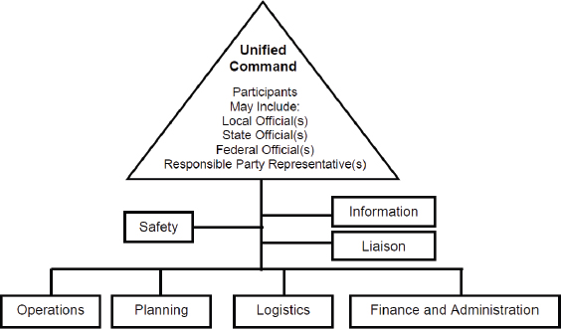
Oil Spill Modeling for Improved Response to Arctic Maritime Spills
Relevance: Emergency Response
ADAC Program Year 7 Annual Meeting 2-3 June 2021
Key Players:
  Incident Command System used by federal government for emergencies
  Unified Command:
    Develops objectives / strategies
    Improves information flow
    Optimizes combined efforts
  USCG responds to marine shipping accidents in U.S. waters
  NOAA ORR provides scientific support to USCG FOSC during oil spill response
Image Source: https://nrt.org/sites/2/files/UC%20TAD%201-26-07%20FINAL.pdf

Slide 6
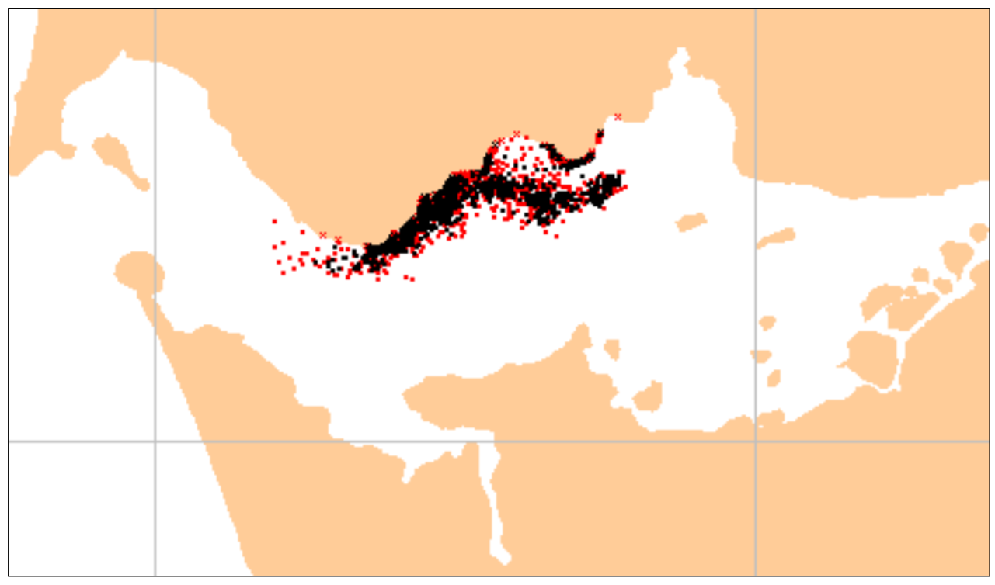
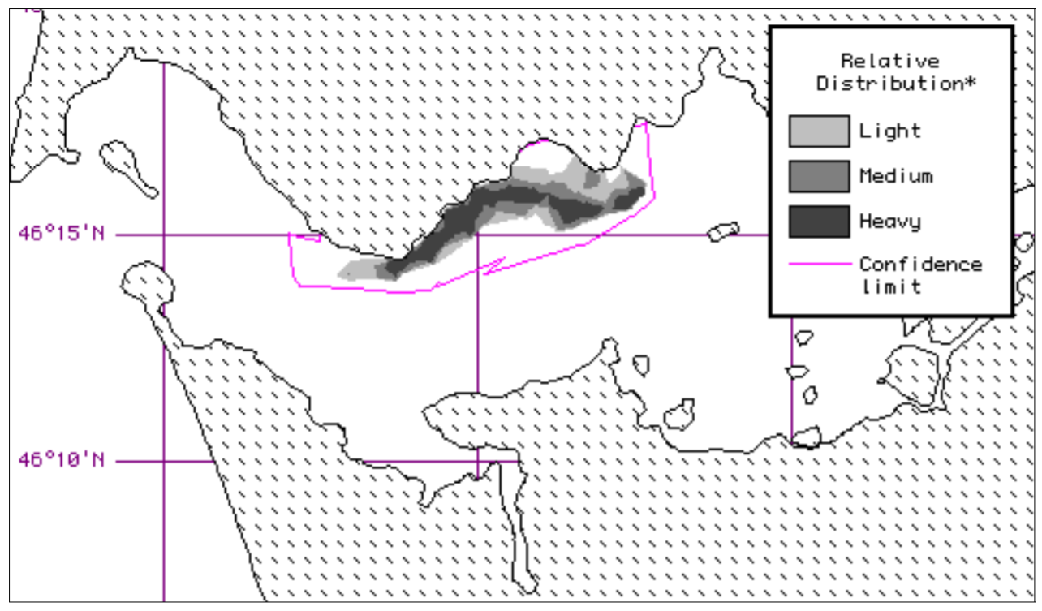
Oil Spill Modeling for Improved Response to Arctic Maritime Spills
Baseline : Oil Spill Models
ADAC Program Year 7 Annual Meeting 2-3 June 2021
Oil spill models:
  Predict the fate & transport of spilled oil
  Use a particle tracking (Lagrangian) based approach
  Are made in U.S. & internationally
  Public or private
Image Source: GNOME User Manual

Slide 7


Oil Spill Modeling for Improved Response to Arctic Maritime Spills
Baseline : Oil Spill Models
ADAC Program Year 7 Annual Meeting 2-3 June 2021
Response models must:
  Initialize quickly (provide answers within hours)
  Calibrate easily
  Model at a wide range of spatial / temporal scales
  Run with minimal data inputs
Primary U.S. Oil Spill Models
NOAA GNOME
RPS OILMAP & SIMAP

Slide 8
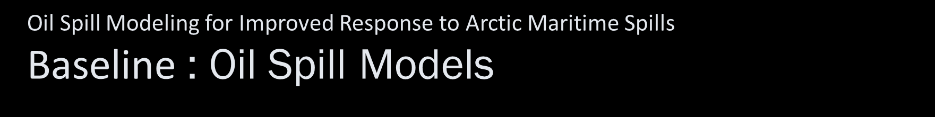
ADAC Program Year 7 Annual Meeting 2-3 June 2021
Transport
Fate (Weathering)
Oil Spill Models Predict:
Fate & Transport of Oil
Advection
Emulsification
Dispersion
Photo-Oxidation
Sedimentation
Dissolution
Biodegradation
Spreading
Evaporation

Slide 9
ADAC Program Year 7 Annual Meeting 2-3 June 2021
Oil Spill Models are Used for:
Directing Response Activities
Informing Stakeholders / Public
Analyzing Performance of
Cleanup Techniques
Identification of Habitats &
Species at Risk

Slide 10
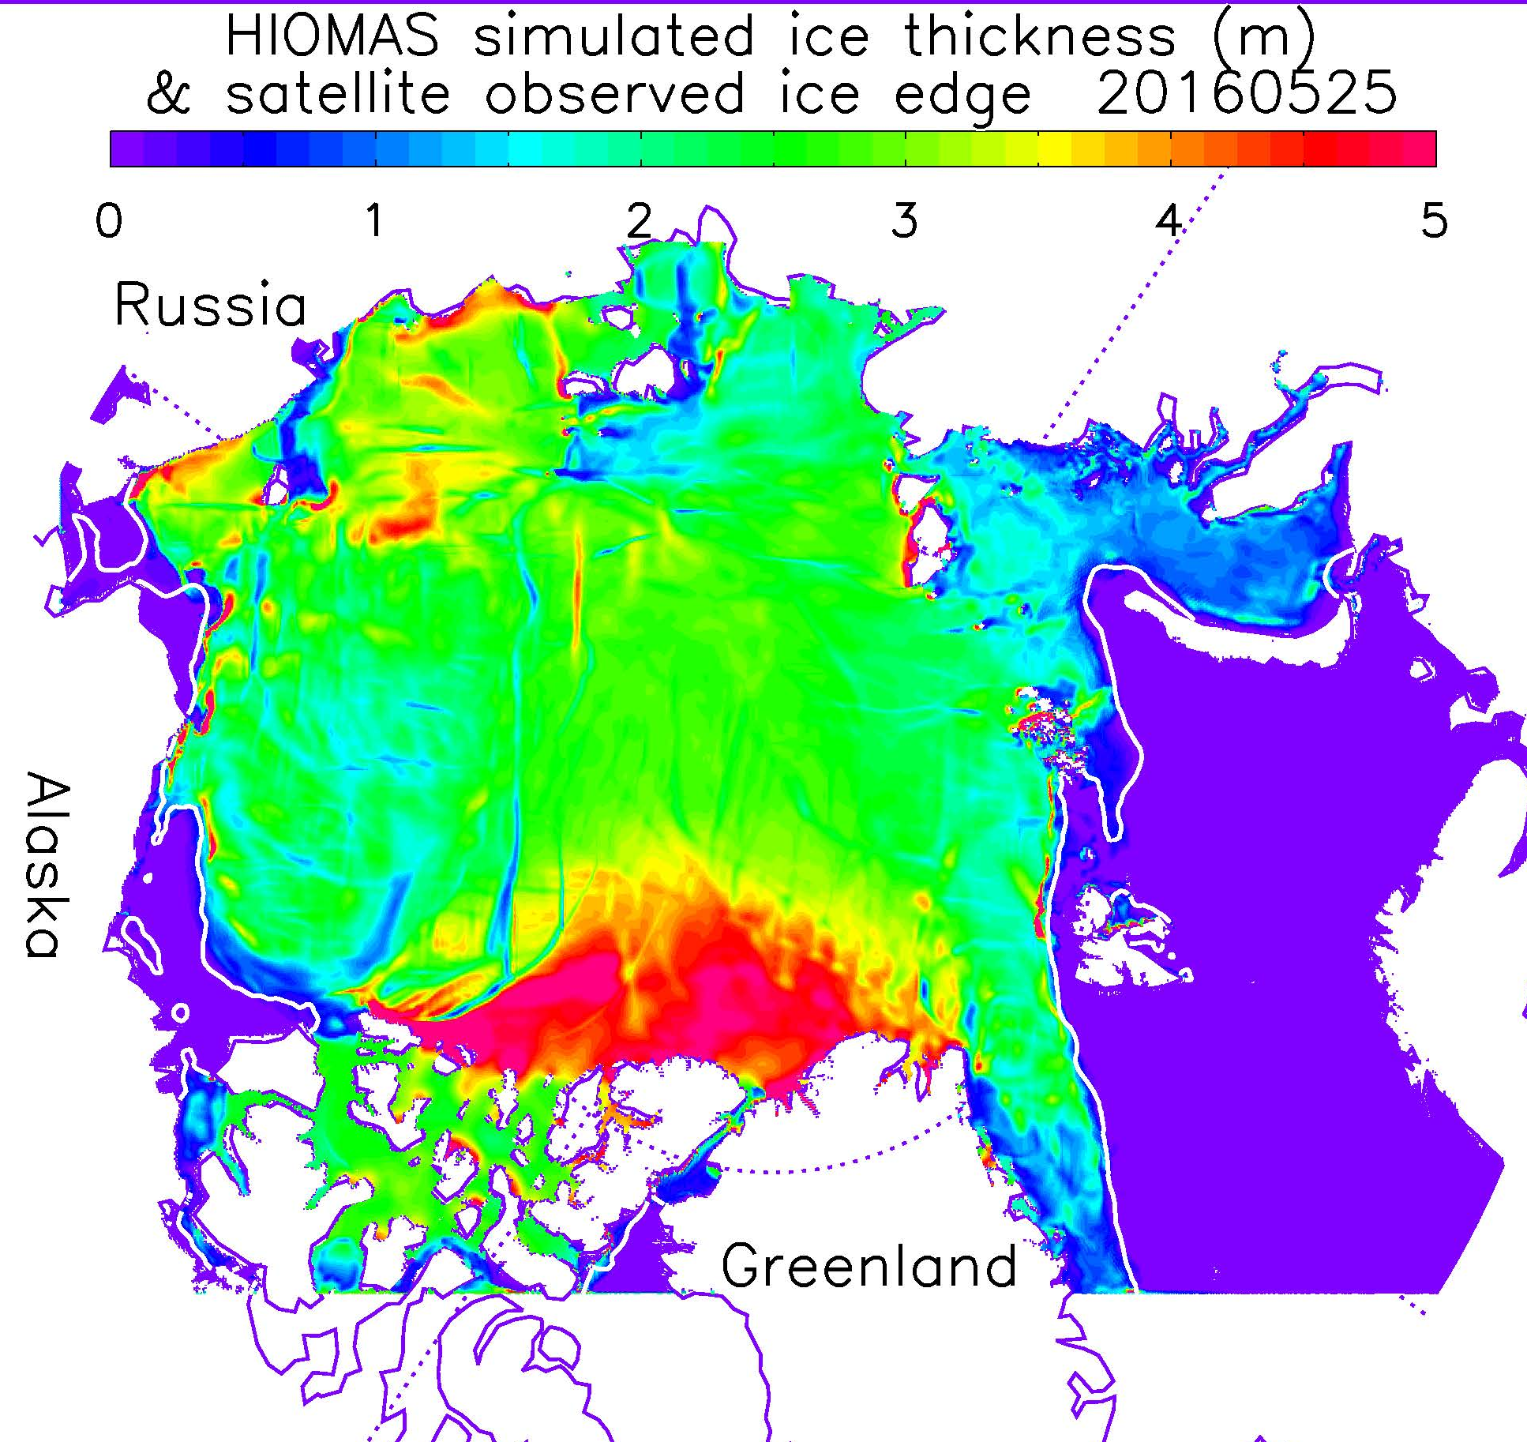
Oil Spill Modeling for Improved Response to Arctic Maritime Spills
Baseline: Ice Models
ADAC Program Year 7 Annual Meeting 2-3 June 2021
Simulate future data about ice conditions
Operate independent of oil spill models
  Essential for estimating spreading &
  transportation of oil in ice
  May be coupled with ocean, land, and/or atmosphere models
Provide long-term, seasonal, & short-term forecasts
Operate at global / climate (> 1 – 2 km) & “sub grid” scales (< 1 km)
Image Source: https://arcticdomainawarenesscenter.org/P08_HIOMAS

Slide 11
Oil Spill Modeling for Improved Response to Arctic Maritime Spills
Baseline : Ice Models
ADAC Program Year 7 Annual Meeting 2-3 June 2021
Ice Models Predict: Future Ice Conditions
Morphology
Physics
Thickness
Ice-Atmosphere
Ridges
Growth & Melt
Biogeochemistry
Floe Size
Ice-Ocean
Source: Adapted from Sea Ice Model Provenance Diagram by Andrew Roberts, Elizabeth Hunke, Bonnie Brown, and Nicole Jeffery

Slide 12
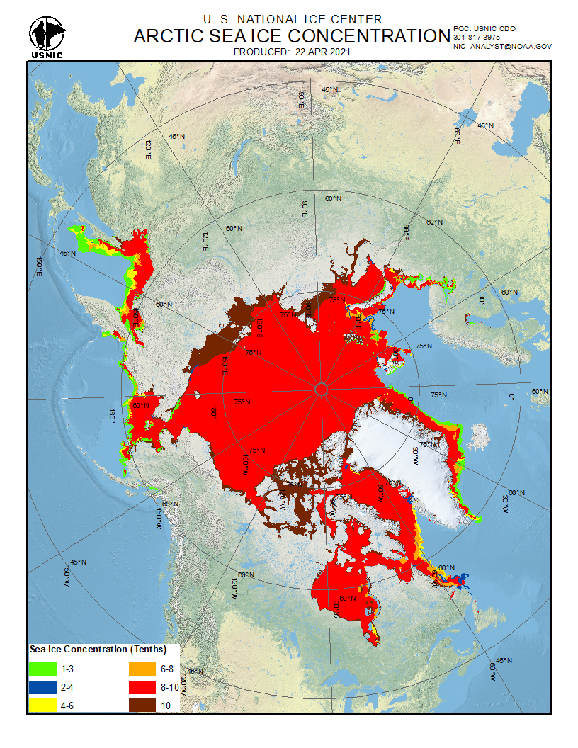
Oil Spill Modeling for Improved Response to Arctic Maritime Spills
Baseline : Ice Observing Systems
ADAC Program Year 7 Annual Meeting 2-3 June 2021
Use satellite resources to identify sea ice:
  Concentration
  Velocity
  Thickness
Information availability based on:
  Satellite orbits
  Radar calibration times
  Environmental conditions (e.g., clouds)
Can provide high resolution data (~10 m)
Use sea ice / hydrodynamic models to predict future conditions
U.S. National Ice Center & NWS AK Sea Ice Program

Slide 13
ADAC Program Year 7 Annual Meeting 2-3 June 2021
Oil Spill Modeling for Improved Response to Arctic Maritime Spills
Method
Phase 1
Phase 2
Phase 3
3 Day Workshop on Arctic Maritime
Spill Response Modeling
Phase 4
Phase 5
Phase 6
Define Needs/ Questions Addressed by Response Models
Formation of Project Core Advisory Team
Working Groups on Oil & Ice Interactions, Technologies, Visualization/ Uncertainty
Virtual Workshop & Stakeholder Working Sessions
Completion of Knowledge Product

Slide 14
ADAC Program Year 7 Annual Meeting 2-3 June 2021
Oil Spill Modeling for Improved Response to Arctic Maritime Spills
Method
Phase 1
Phase 2
Phase 3
3 Day Workshop on Arctic Maritime
Spill Response Modeling
Phase 4
Phase 5
Phase 6
Define Needs/ Questions Addressed by Response Models
Formation of Project Core Advisory Team
Working Groups on Oil & Ice Interactions, Technologies, Visualization/ Uncertainty
Virtual Workshop & Stakeholder Working Sessions
Completion of Knowledge Product

Slide 15
ADAC Program Year 7 Annual Meeting 2-3 June 2021
Oil Spill Modeling for Improved Response to Arctic Maritime Spills
Method: Phase 1: Core Team Formation
Core Team
USCG
PacArea (Pacific Area)
D17 (Alaska)
NOAA OR&R
Marine Environmental Response (MER)
5RI (Office of Incident Management)
Alaska Department of Environmental Conservation (DEC)
ADAC
Provided input monthly from April 2019 to March 2021 & Review/
Edit Final Knowledge Product

Slide 16
ADAC Program Year 7 Annual Meeting 2-3 June 2021
Oil Spill Modeling for Improved Response to Arctic Maritime Spills
Method: Phase 2: Define Needs Addressed by Response Models
Project Core Team meeting held on May 2019
Produced Needs / Questions related to:
  Responder / FOSC Needs
  Overview & concerns for existing models
  Desired capabilities for new models
  Confidence level & communication
  Validation of models
  Suggestions for first workshop
Needs / Questions finalized by Core Team on July 31, 2019

Slide 17
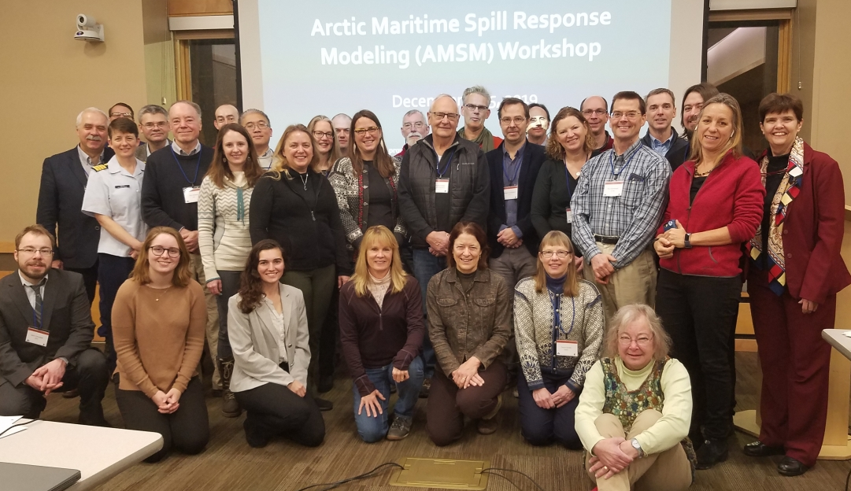
ADAC Program Year 7 Annual Meeting 2-3 June 2021
Oil Spill Modeling for Improved Response to Arctic Maritime Spills
Method: Phase 3: Workshop 1 on AMSM Modeling
AMSM Workshop (December 3-5, 2019):
  49 participants from U.S. & International
  Presentations on oil spill & ice models available for Arctic
  Three different breakout group scenarios:
    Well blowout under ice
    Pipeline spill under landfast ice
    Large vessel spill of combinations of oil in the shoulder season (Fall)
  Workshop report completed January 2020

Slide 18
ADAC Program Year 7 Annual Meeting 2-3 June 2021
Oil Spill Modeling for Improved Response to Arctic Maritime Spills
Method: Phase 4: Formation of Working Groups
Working Group Topics were determined at December 2019 workshop
Met March - November 2020
  Online every 3 weeks for 1 hour (~ 12 meetings
  per group)
  Each group has NOAA ORR modeling
  representative
Group Topics were determined at December 2019 workshop
Met March - November 2020
Working Group Topics
Oil & Ice Interactions at the Meter / “Sub Grid” Scale
Oil & Ice Interactions at the Kilometer + Scale
New and Existing Technologies for Observing Ice and Informing Models
Visualization & Uncertainty

Slide 19
ADAC Program Year 7 Annual Meeting 2-3 June 2021
Oil Spill Modeling for Improved Response to Arctic Maritime Spills
Method: Phase 5: Virtual Workshop
Three parts:
  Workshop: November 16, 2020 (~ 75 participants)
  Stakeholder Working Session I: November 23, 2020
  Stakeholder Working Session II: November 30, 2020
Groups presented goals, research gaps, & findings
Stakeholder Working Sessions focused identifying research needs / scopes of work
9 workshop
Met March - November 2020

Slide 20


ADAC Program Year 7 Annual Meeting 2-3 June 2021
Oil Spill Modeling for Improved Response to Arctic Maritime Spills
Method: Phase 6: Knowledge Product
Megan Verfaillie’s Thesis Defense = May 18, 2021
Jessica Manning Senior Thesis =
May 20, 2021
Both ADAC Fellows
Knowledge Product will be
submitted June 30
Megan Verfaillie
Jessica Manning

Slide 21
ADAC Program Year 7 Annual Meeting 2-3 June 2021
Oil Spill Modeling for Improved Response to Arctic Maritime Spills
Findings and Key Accomplishments
Needs / Questions from Responder / FOSC Perspective
Where did the spill occur,
where is it going, available assets, where to assign personnel?
Confidence vs. uncertainty, what is the probability of the predicted outcome?
Implications of the model on response tactics?
Acceptable model run time / resolution
Who is going to use / report the results of the model?
How acceptable is the model going to be to corporate partners / responsible party?

Slide 22
ADAC Program Year 7 Annual Meeting 2-3 June 2021
Oil Spill Modeling for Improved Response to Arctic Maritime Spills
Findings and Key Accomplishments
Needs / Questions from Responder / FOSC Perspective
Where did the spill occur,
where is it going, available assets, where to assign personnel?
Confidence vs. uncertainty, what is the probability of the predicted outcome?
Implications of the model on response tactics?
Acceptable model run time / resolution
Who is going to use / report the results of the model?
How acceptable is the model going to be to corporate partners / responsible party?

Slide 23
ADAC Program Year 7 Annual Meeting 2-3 June 2021
Oil Spill Modeling for Improved Response to Arctic Maritime Spills
Findings and Key Accomplishments
Needs / Questions on Confidence and Communication
How to estimate qualitative confidence level for models?
Models and inputs should be made available to all parties
How to improve communication of results (audience & medium)
What kind of inputs are needed to obtain a certain confidence?
How to translate outputs to a “layperson’s level”
Terms mean different things to different people

Slide 24
ADAC Program Year 7 Annual Meeting 2-3 June 2021
Oil Spill Modeling for Improved Response to Arctic Maritime Spills
Findings and Key Accomplishments
Needs / Questions on Confidence and Communication
How to estimate qualitative confidence level for models?
Models and inputs should be made available to all parties
How to improve communication of results (audience & medium)
What kind of inputs are needed to obtain a certain confidence?
How to translate outputs to a “layperson’s level”
Terms mean different things to different people

Slide 25
ADAC Program Year 7 Annual Meeting 2-3 June 2021
Oil Spill Modeling for Improved Response to Arctic Maritime Spills
Findings and Key Accomplishments
State-of-the-Art Models
Completed a comprehensive review of state-of-the-art oil spill and ice models / forecast systems available
  Produced tables on state-of-the-art oil spill & ice models
    Spreadsheets include logistical information (e.g., scales, file formats), algorithms, necessary inputs, and outputs
  Oil spill modelers created lists of:
    Current limitations for oil in ice algorithms
    Outputs from sea ice models useful for improving Arctic oil spill modeling

Slide 26
ADAC Program Year 7 Annual Meeting 2-3 June 2021
Oil Spill Modeling for Improved Response to Arctic Maritime Spills
Findings and Key Accomplishments
Model Integration: Scale of Available Data
Spatial & temporal resolution (scale) needed for oil spill model inputs is smaller than what most ice models produce
  Most ice models operate at the global / climate or sub grid scale
  Ice observing systems can produce needed resolution, but are limited by weather, satellite revisit periods & ingestion into models
Major obstacle for improving interoperability

Slide 27
ADAC Program Year 7 Annual Meeting 2-3 June 2021
Oil Spill Modeling for Improved Response to Arctic Maritime Spills
Findings and Key Accomplishments
Model Integration: Scale of Available Data
Oil spill modelers want data at 1 km spatial resolution & hourly temporal resolution
Challenging to produce at these scales
  1 km is intermediate scale between climate / global & sub grid scale
  Averaging of data across grid cells does not adequately represent regional scale processes in response timeframe
  Required computing power / data storage
  Complex Arctic environment
  Technology limitations / data availability

Slide 28
ADAC Program Year 7 Annual Meeting 2-3 June 2021
Oil Spill Modeling for Improved Response to Arctic Maritime Spills
Findings and Key Accomplishments
Model Integration: Oil Spill Algorithms
Existing oil-in-ice algorithms approximate true conditions
Limited data to improve them
Models use similar large-scale oil-in-ice algorithms
  80/20 rule uses ice concentration to explain how fate / transport changes with ice
  Concentration sourced from ice models or observational charts

Slide 29
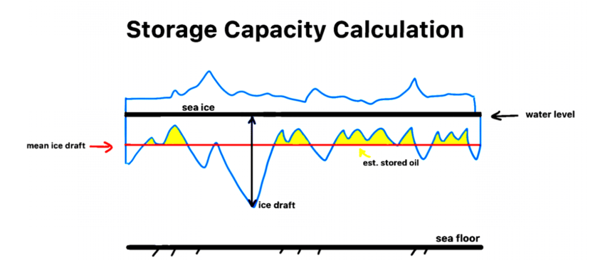
ADAC Program Year 7 Annual Meeting 2-3 June 2021
Oil Spill Modeling for Improved Response to Arctic Maritime Spills
Findings and Key Accomplishments
Many important small-scale oil-in-ice processes are not modeled
Most important is estimation of under ice storage capacity
  Based on roughness & stripping velocity
  Few data available for under ice conditions
  Relationship between under ice and surface conditions is not well understood
  “Rule of thumb” needed to estimate holding capacity of sea ice
Source: Kelsey Frazier, ADAC, December 2019 Workshop Presentation: “Oil and Ice”

Slide 30
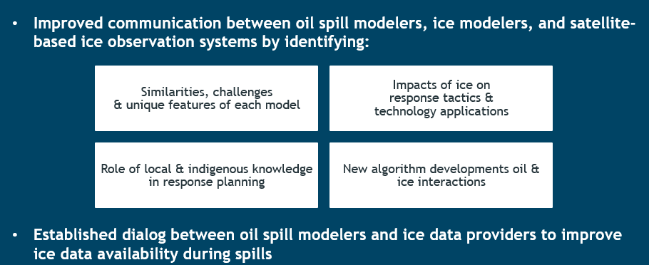
ADAC Program Year 7 Annual Meeting 2-3 June 2021
Oil Spill Modeling for Improved Response to Arctic Maritime Spills
Findings and Key Accomplishments
Data Communication / Availability

Slide 31
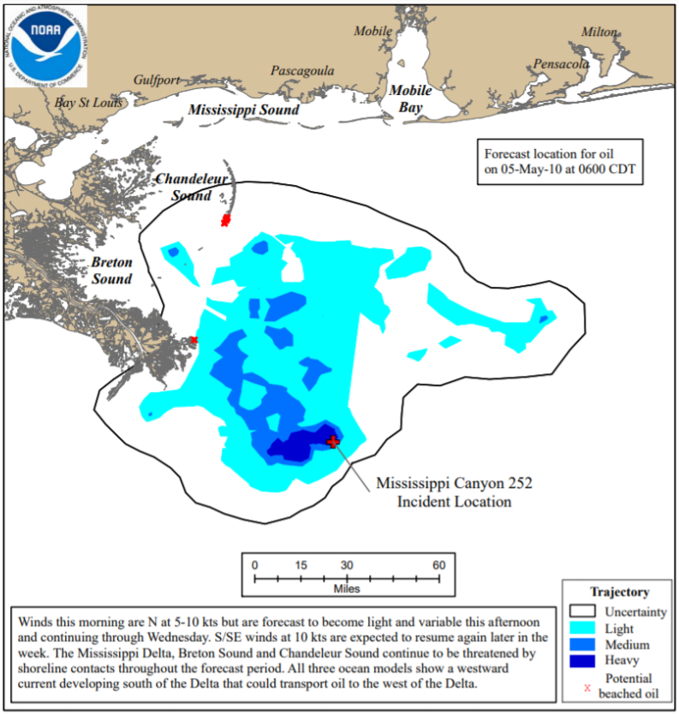
ADAC Program Year 7 Annual Meeting 2-3 June 2021
Oil Spill Modeling for Improved Response to Arctic Maritime Spills
Findings and Key Accomplishments
Communication of Uncertainty
FOSCs are concerned with:
  Most likely prediction
  Worst-case scenario
  Implications on response
Qualitative confidence level
(low, medium, high) sufficient
for decision-making
Spill modelers usually have idea
of qualitative uncertainty of outputs

Slide 32
ADAC Program Year 7 Annual Meeting 2-3 June 2021
Oil Spill Modeling for Improved Response to Arctic Maritime Spills
Findings and Key Accomplishments
Communication of Uncertainty
NOAA OR&R modelers recommend
visualizations that include:
  Color coded, general, qualitative confidence levels
  Clear uncertainty bounds
  Summary of missing data

Slide 33
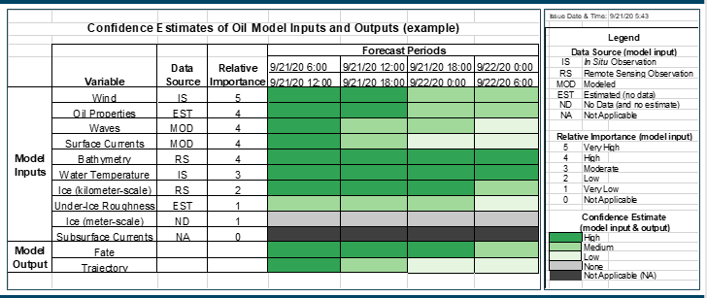
ADAC Program Year 7 Annual Meeting 2-3 June 2021
Oil Spill Modeling for Improved Response to Arctic Maritime Spills
Findings and Key Accomplishments
AMSM Confidence Estimates of Oil Model Inputs & Outputs (CEOMIO)
Identifies:
  Sources of uncertainty
  Qualitative confidence levels for
  inputs / outputs over spill duration
  Input data gaps & quality issues
Next step: sub-group of oil spill modelers and
SSCs using model output and data from
previous incidents to create draft tables
  Tables will be introduced to responders at a seminar and/or tabletop
  Also presented to other relevant groups (e.g., Alaska RRT)

Slide 34
ADAC Program Year 7 Annual Meeting 2-3 June 2021
Oil Spill Modeling for Improved Response to Arctic Maritime Spills
Findings and Key Accomplishments
AMSM Confidence Estimates of Oil Model Inputs & Outputs (CEOMIO)

Slide 35
ADAC Program Year 7 Annual Meeting 2-3 June 2021
Oil Spill Modeling for Improved Response to Arctic Maritime Spills
Findings and Key Accomplishments
Technology / Data Needs for Arctic Spill Response
Created spreadsheet describing:
  Contact / Manufacturer
  Overview
  Sensor Description
  Operating Conditions
  Spatial & Temporal Resolution
  Time Required for Measurements
  Availability / Time for Mobilization
  Permit Requirements
  Raw & Final Data Formats
  Validation Studies
Satellites
Airborne
On Ice Surface & Subsurface
Under Ice & Open Water Surface
Seafloor Mounted

Slide 36
ADAC Program Year 7 Annual Meeting 2-3 June 2021
Oil Spill Modeling for Improved Response to Arctic Maritime Spills
Findings and Key Accomplishments
Technology / Data Needs for Arctic Spill Response
Determined technology applicability and limitations for two spill scenarios:
Large Vessel Spill of Combinations of Oil in the Shoulder Season
Pipeline Spill Under Landfast Ice

Slide 37
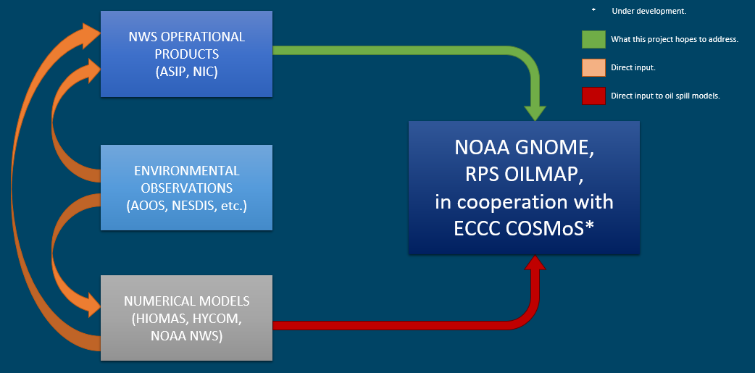
ADAC Program Year 7 Annual Meeting 2-3 June 2021
Oil Spill Modeling for Improved Response to Arctic Maritime Spills
Transition Plans
The Path Forward
Year 7 will conclude with completion of the Knowledge Product
Year 8 will determine necessary data feeds from ice models to predict trajectory of oil in ice
  Coding to get data from
  ice models / services ready
  for ingestion into oil spill models
  Tabletop exercise to test
  linkage between ice and oil spill models

Slide 38
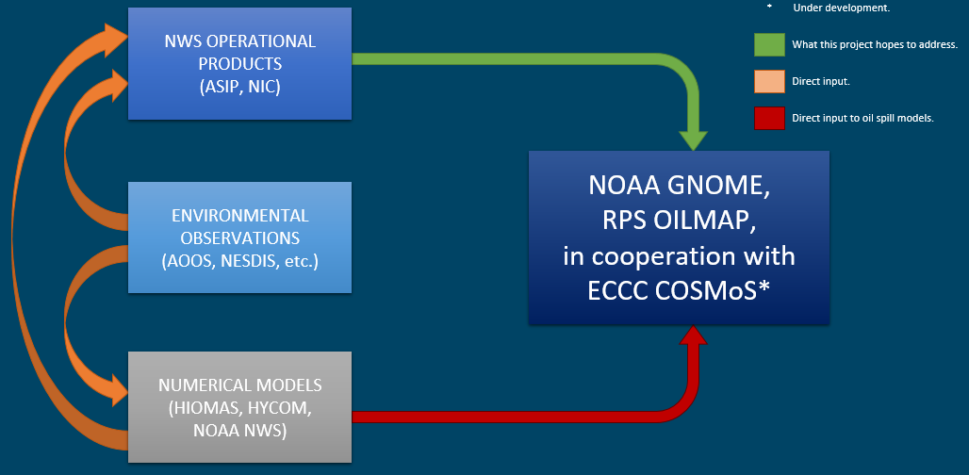
Questions?
ADAC Program Year 7 Annual Meeting 2-3 June 2021
Feedback…
What are we missing?
What can we improve?
Who should we connect with to improve odds of success?
Notes:
Thank you for the gift of your time and attention.

